Slide 1
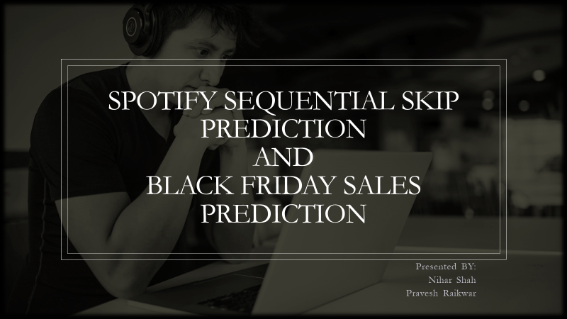

Slide 2


Problem definitions
Spotify Sequential Skip Prediction
Black Friday Sales Prediction

Slide 3


Definition
This is a random user
No Skip
Given a song
Start
End

Slide 4
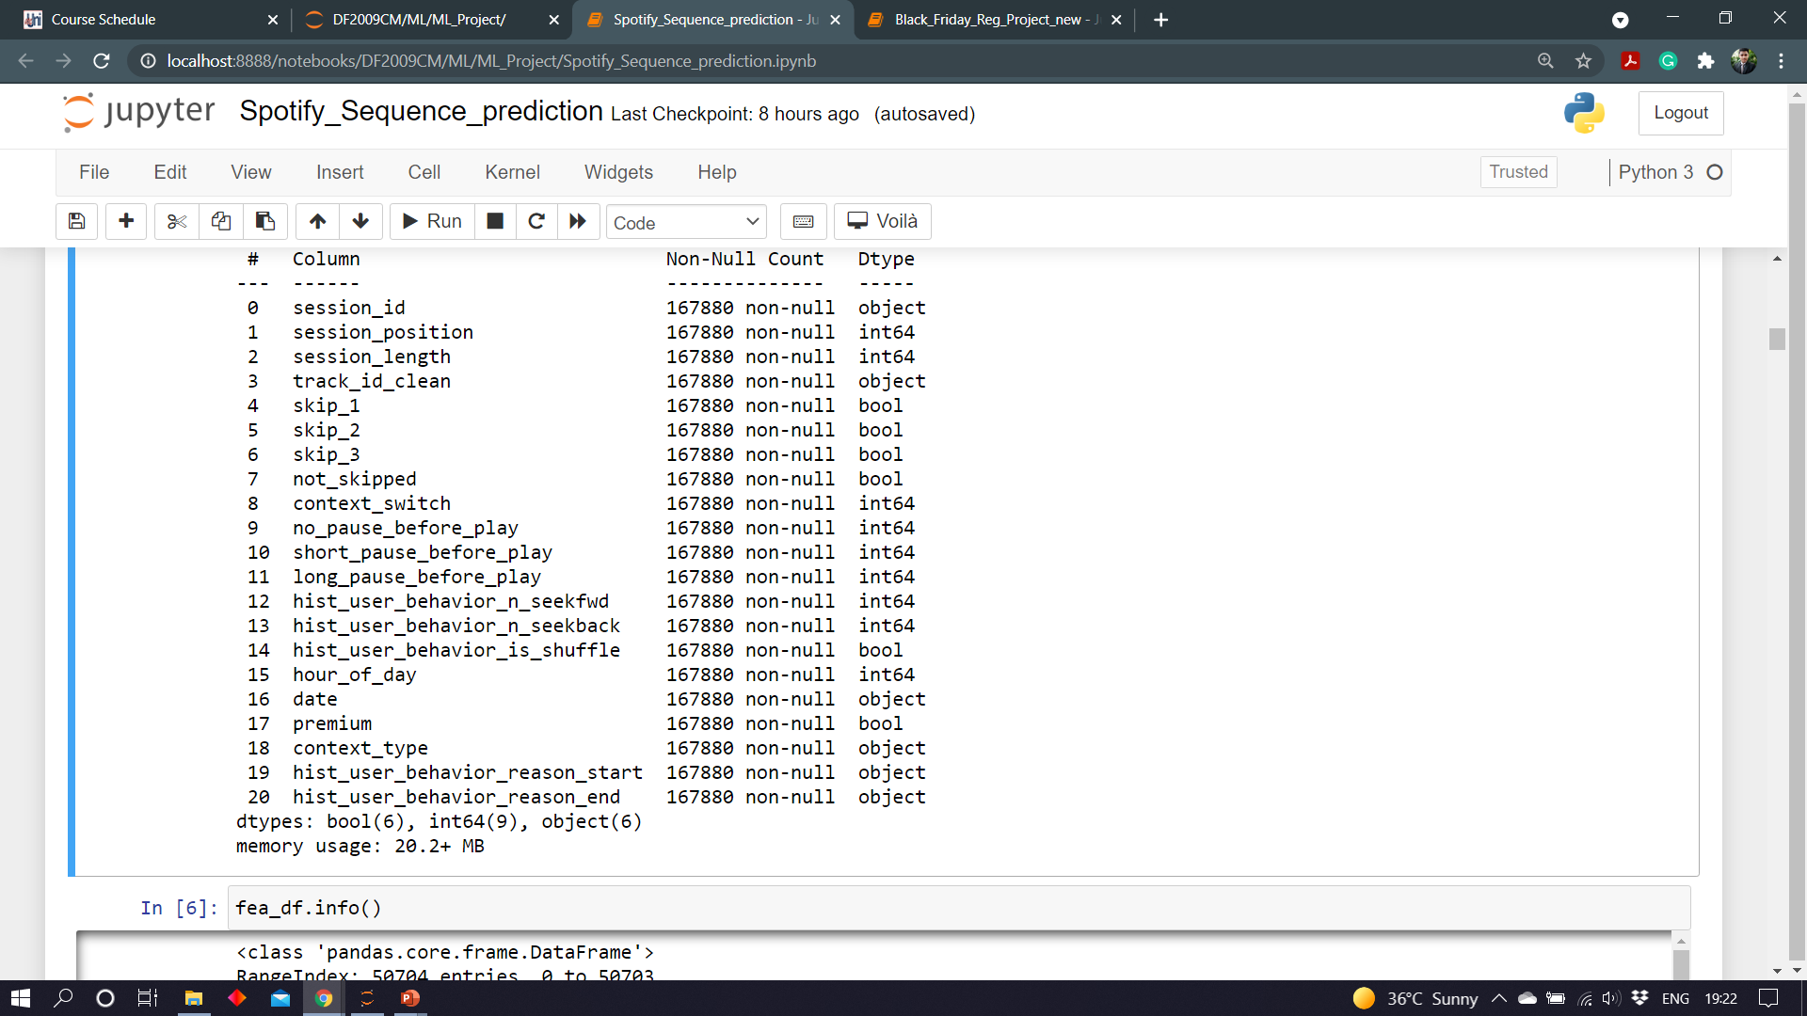
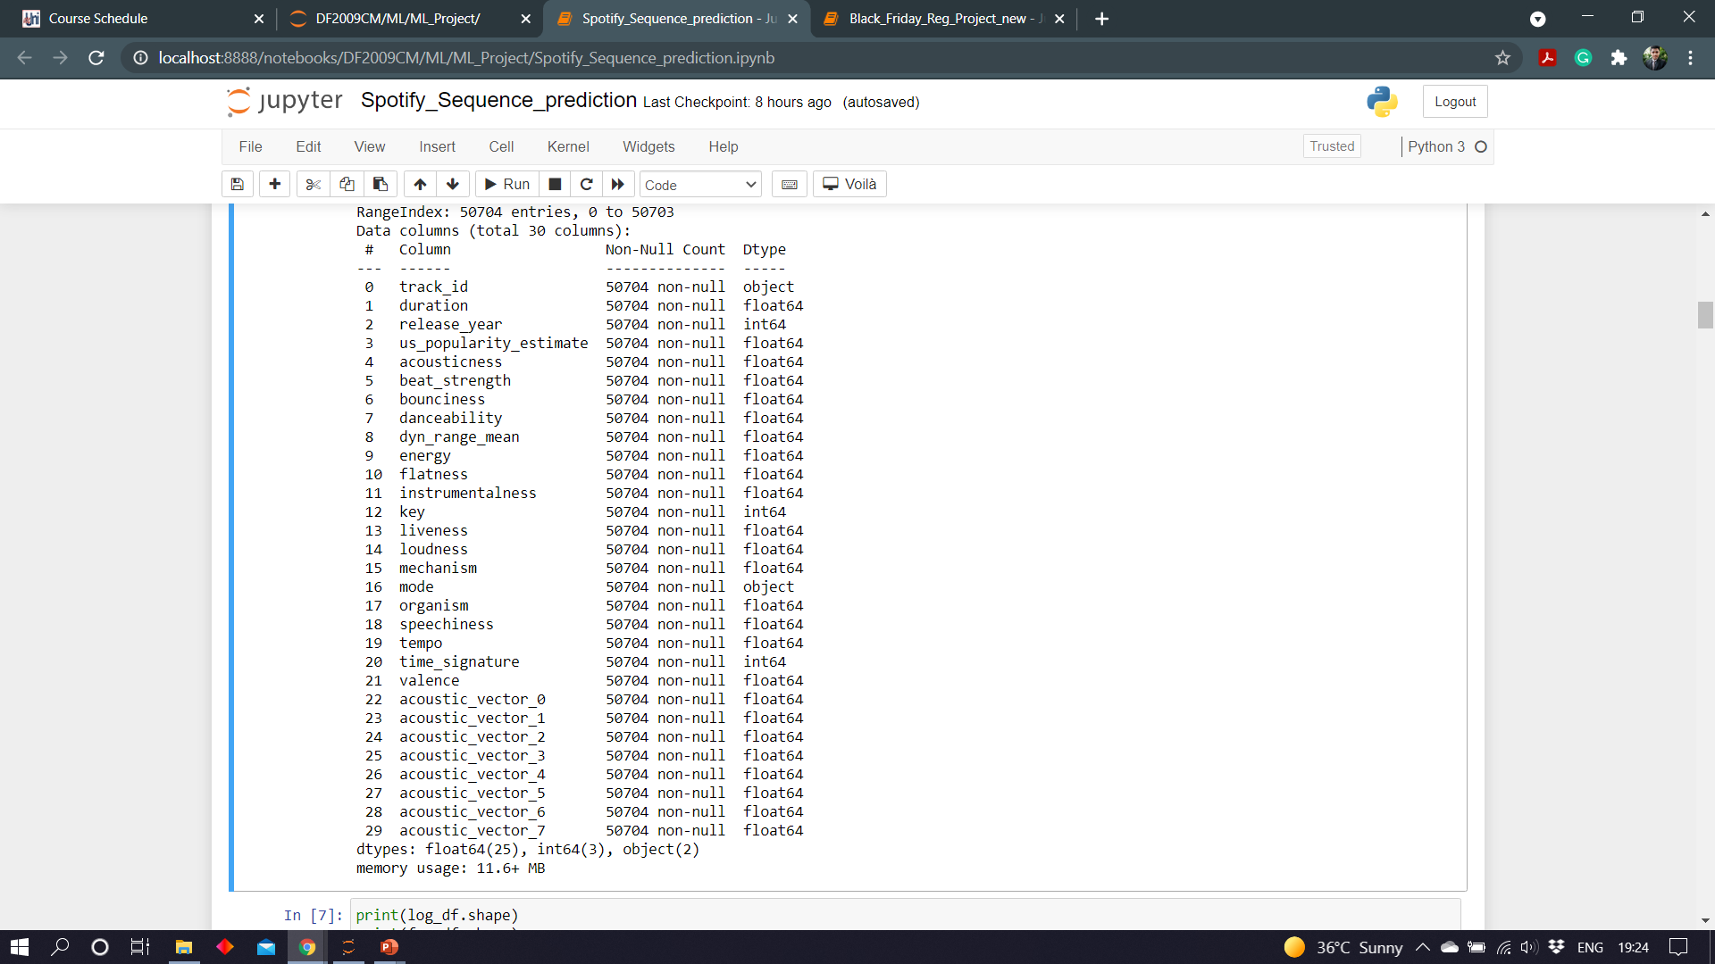
Features in the data
Table 1(user log)
Table 2 (song data)

Slide 5
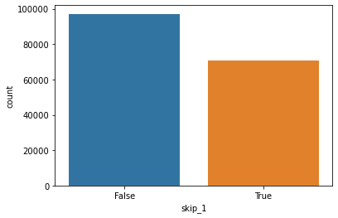
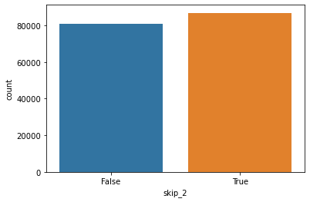
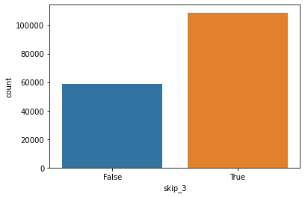
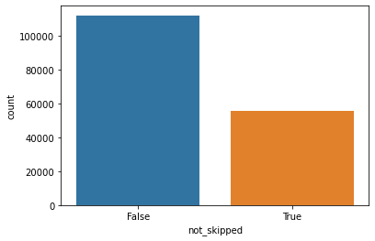
Understanding the data
167880 Total Records

Slide 6
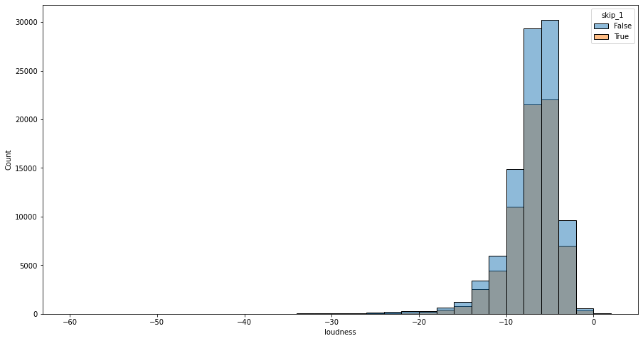
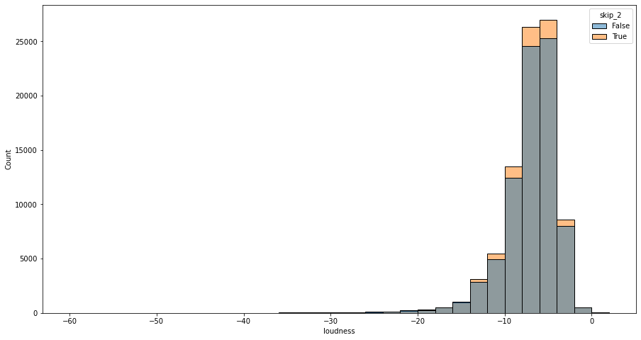
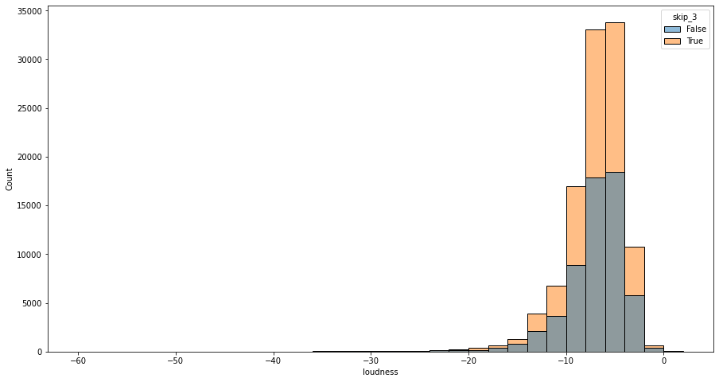
Can loudness of song impact the skip?
Songs are being skipped in phase 2 and 3 more. But the count of skips is normally distributed over loudness

Slide 7
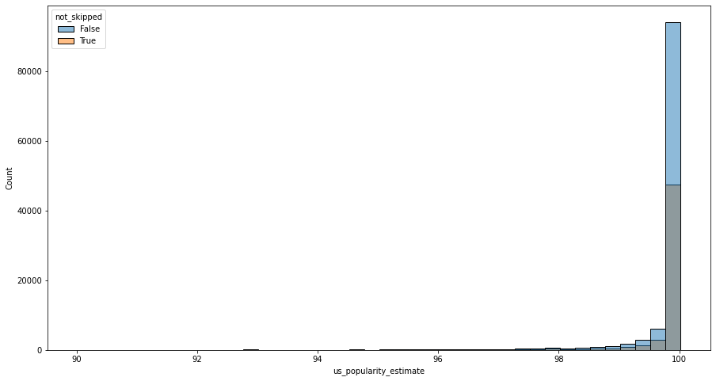
Can the popularity of song impact skip?
Seems like more the song’s popularity More are they being skipped. But on the other hand, in each bin around 50% of the songs are being skipped.

Slide 8
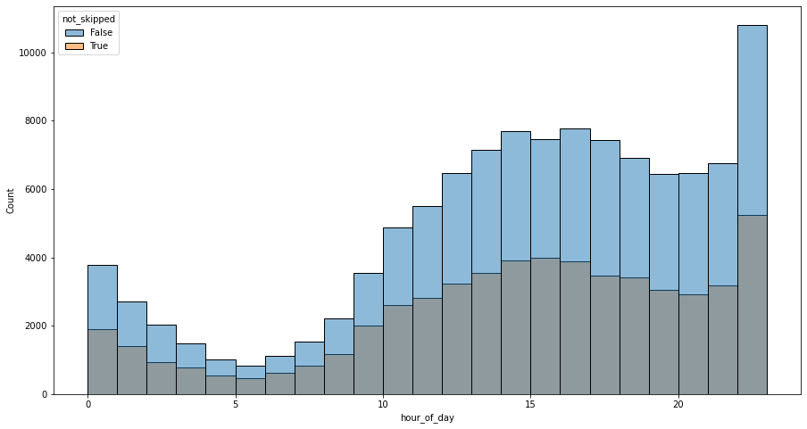
Can the hour of day impact Skip?
Time slot of 22-midnight registers the maximum song requests. But overall proportion of skips remains around that 50% mark.

Slide 9
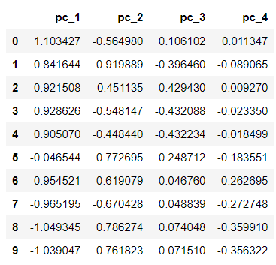
PCA
Understanding the impact of 70 features is very difficult.
Transformed those 70 features into 4 principle components.
The variability explained by those components is around 0.98389601≈ 98%

Slide 10
Balanced scorecard slide 5
Model SCORECARD
Explanibility
Execution Time
Practical to implement
Accuracy
0.8049
Logistic Regression
0.8054
KNN
0.9274
Random Forest
0.6380
SVM

Slide 11





Definition
Company ABC
Given User
Last Month
Customer Purchase
Behavior data
What will be the purchase amount

Slide 12
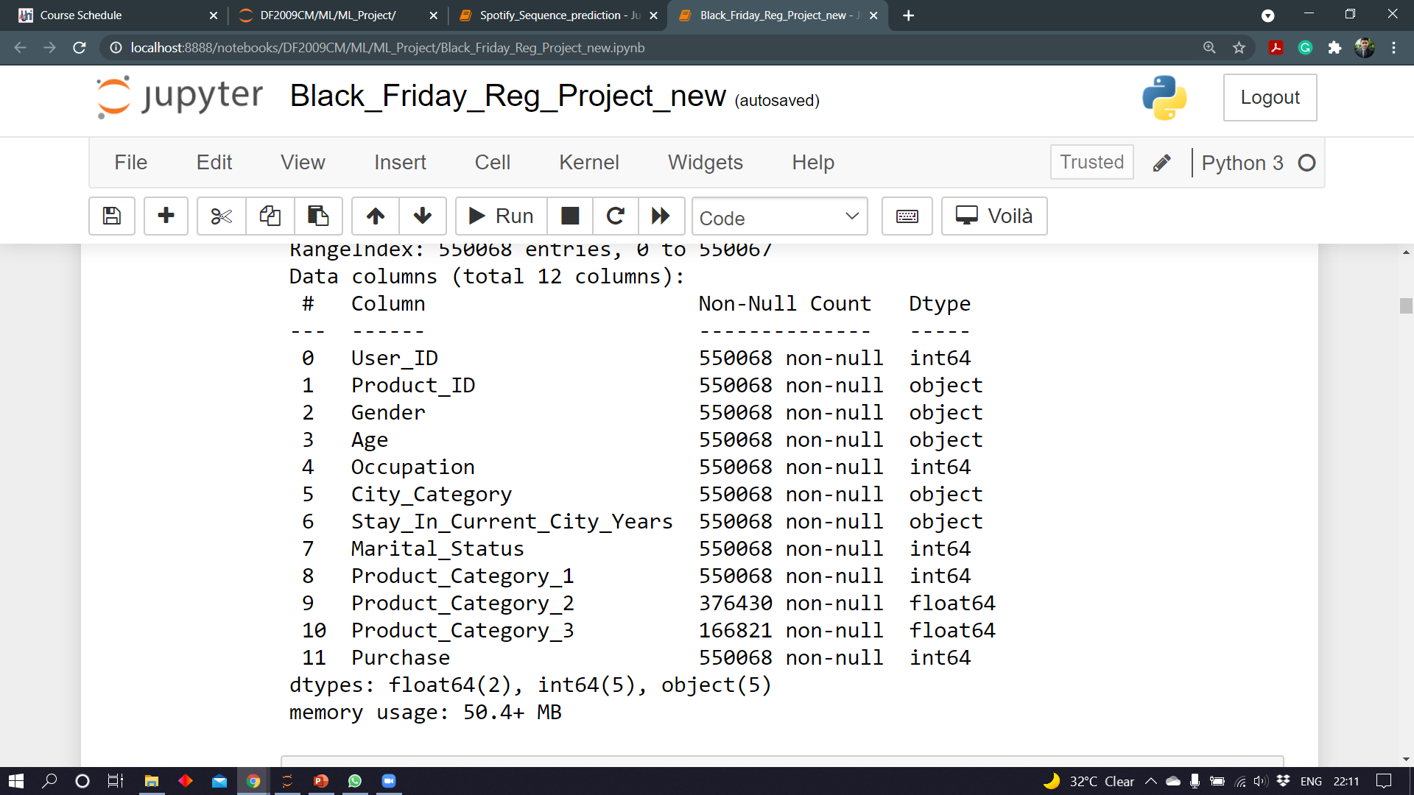
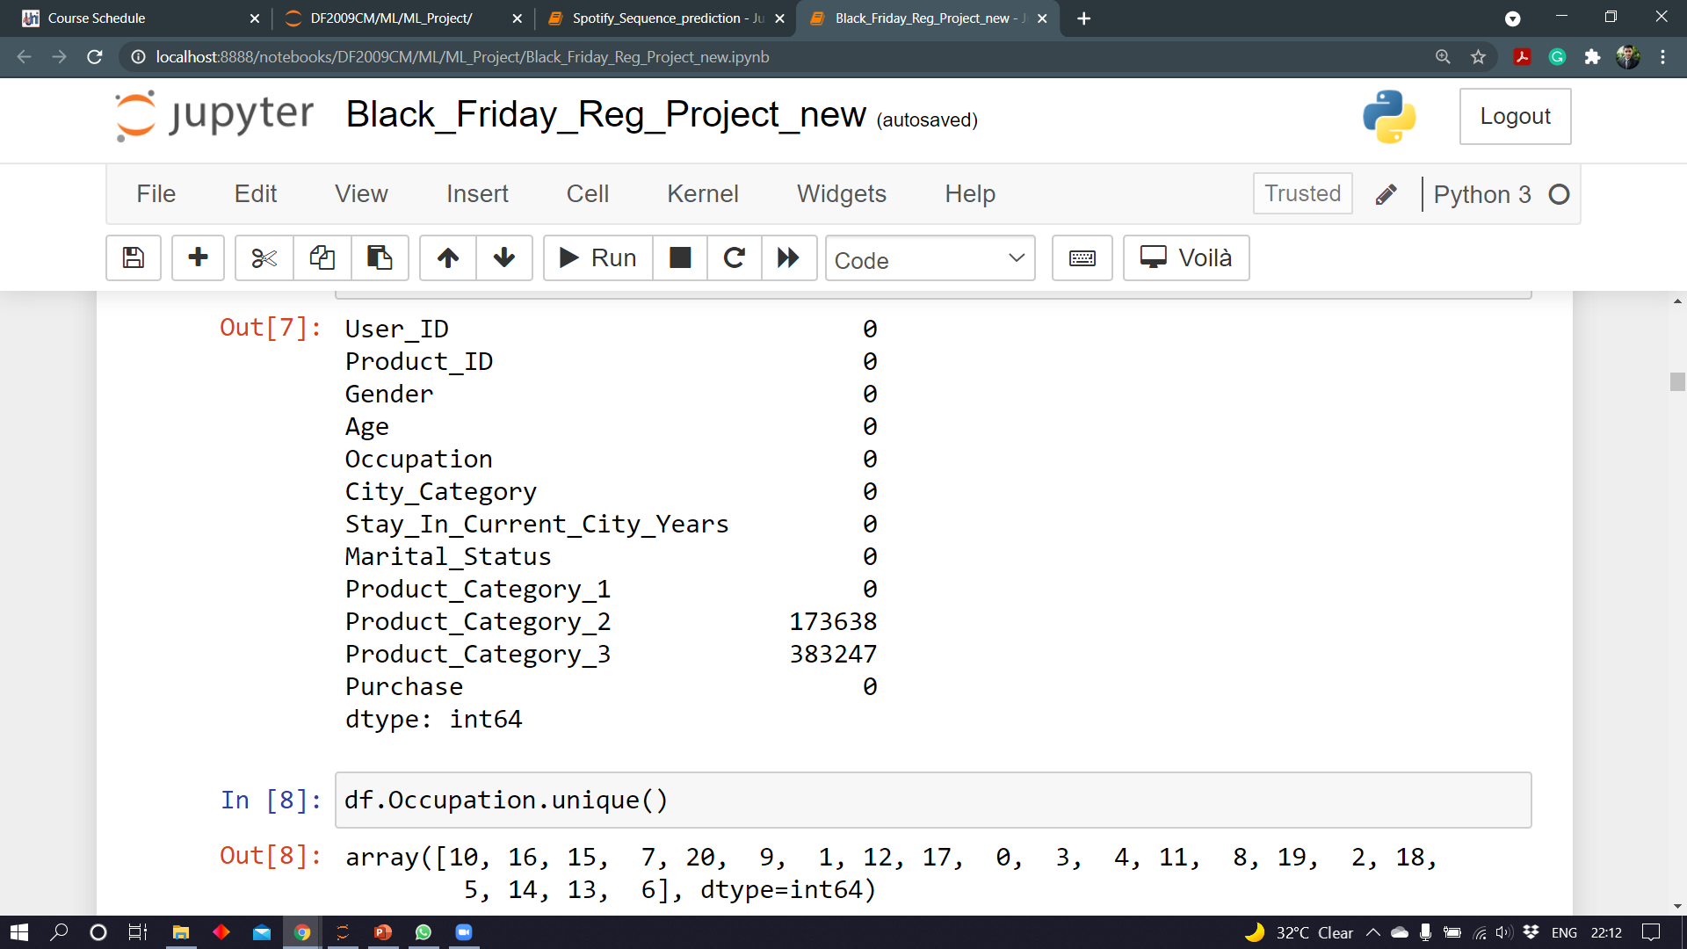
Features in the data
Null Value Count

Slide 13
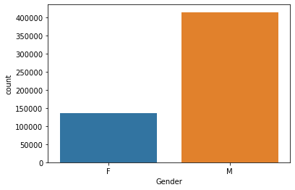
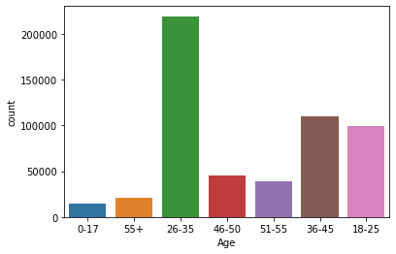
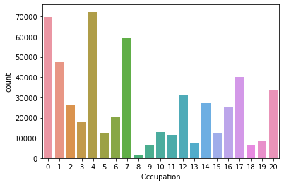
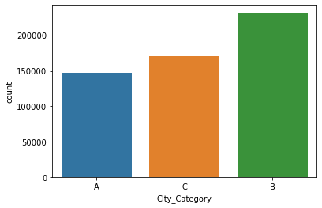
Understanding the data

Slide 14
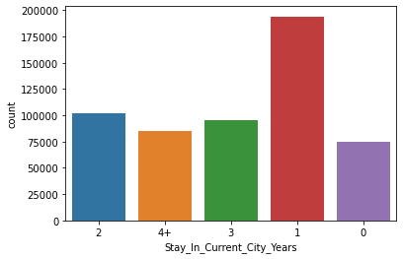
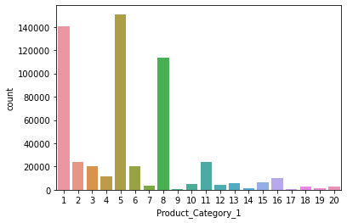
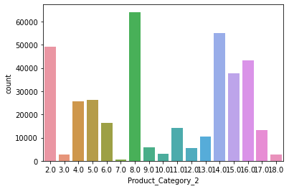
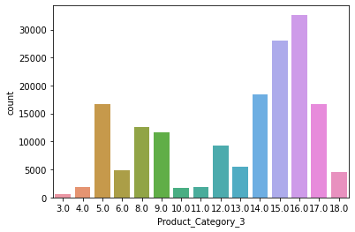

Slide 15
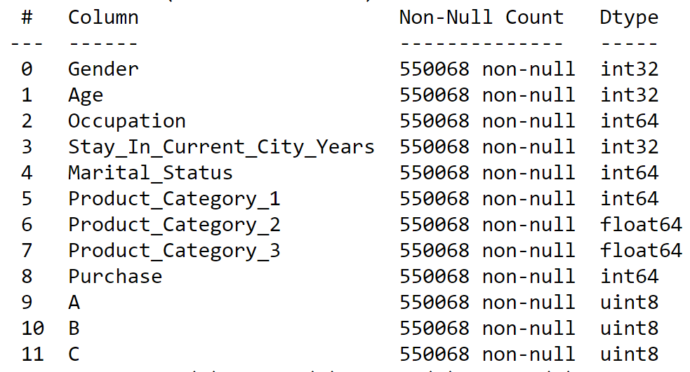
Processing the data
Applied one hot/label encoding on categorical features
Filled missing values with Constant

Slide 16
Balanced scorecard slide 5
Model SCORECARD
Explanibility
Execution Time
Practical to implement
Score
0.1449
Linear Regression
0.5673
Decision Tree
0.6381
Random Forest
0.6638
XGBoost

Slide 17
Thank You

